Slide 1
NCHRP 25-25 TASK 105: Connecting Transportation and Health: A Guide to Communication and Collaboration
January 2021
Notes:
Let me introduce you to A Guidebook for Communications between Transportation and Public Health Communities. This guidebook is the product of National Cooperative Highway Research Program (NCHRP) project 25-25 Task 105.
I am going to take a few minutes to share information about the Guide and its companion products – and make a request of you today.

Slide 2
The Goals for Developing the Guidebook
Build on best practices for transportation and health collaboration
Create an accessible, practitioner-ready communications guidebook
Provide resources to support effective communications for a wide range of users
Notes:
This guidebook is meant to support collaboration among transportation and health professionals. Enough detail is provided to support communications with public health agencies and stakeholders. The hope is to bridge differing perspectives and communications approaches. The tools and resources from the Guidebook are also available separately. These include a quick reference guide to support outreach and communications efforts.
The guidebook can be used both by agencies already coordinating with the health sector and agencies newly reaching out. Public health stakeholders studying the transportation process can use this as a reference. Both disciplines will find opportunities for integrating health with transportation efforts.

Slide 3
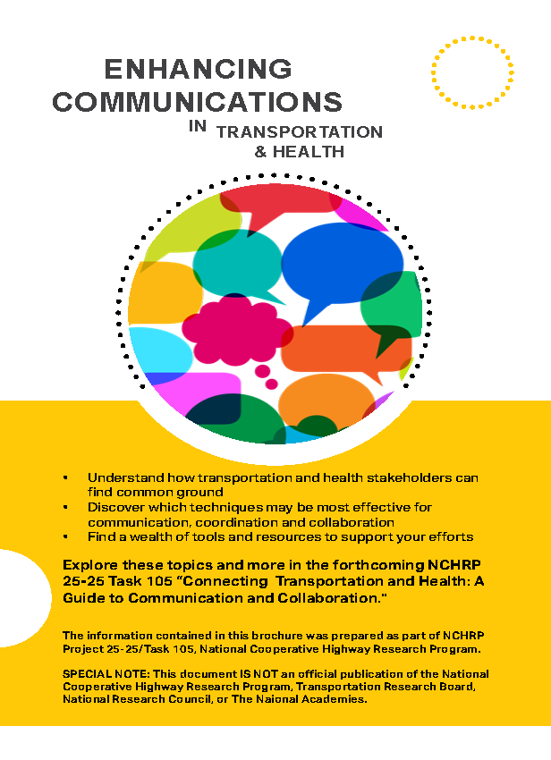
Research Products
Communications Guidebook and Tools
Recorded Overview Presentation
Presentation Slides with Speaker Notes
Summary Brochure
Project Summary Report
http://bit.ly/TransportationHealthCommunicationsGuidebook
Notes:
The Task 105 project resulted in several work products that are available for use along with the Guidebook. These include a quick reference file for those independent resources mentioned on the previous slide. A printable gives a quick overview of what the guidebook has to offer. A recorded overview presentation is available online with a little more detail than today’s presentation. A summary report gives a brief overview of all the work done for the project.
The slides I am sharing today are drawn from the “presentation slides with speaker notes” reflected on this slide.

Slide 4
Key Intersections
Transportation and Public Health Context
How do transportation and health relate?
Safety and
Injury Prevention
Physical Activity/ Active Transportation
Air Quality
Connectivity and Access
Evacuation and Emergency Response
Equity
Transportation
Health
FHWA Health in Transportation Objectives
Mobility and access
Freight/goods movement
Economic opportunity
Environmental stewardship
Quality of life
Population health
Food access/security
Reduce chronic disease
Prevent infections disease spread
Protect vulnerable populations
Transportation and Health Intersections
Notes:
Transportation and health communities have overlapping goals and interests in several key categories. These include safety and injury prevention; physical activity and active transportation; air quality; connectivity and access; evacuation and emergency response; and equity. Differences between transportation and health perspectives are reviewed to identify opportunities for communications.
Optional/Supporting Information:
FHWA’s Health in Transportation Objectives also discusses intersections between transportation and health.

Slide 5
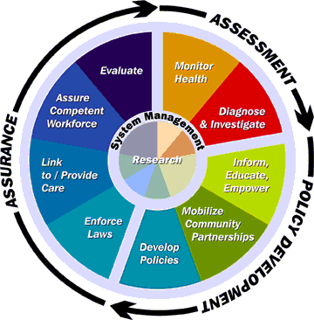
Health Processes and Initiatives
Transportation and Public Health Context
What are the key goals and process steps for health?
Health in all Policies
Community Health Needs Assessment (CHNA)
Community Health Improvement Plan (CHIP)
Health Impact Assessment (HIA)
Infrastructure Projects
Health Districts
Health Campaigns
Health Process Steps
Common Public Health Goals
Intersecting Transportation and Health in Clackamas County, OR
Spokane Regional Health District
Wabasso, Florida Community Infrastructure Improvements
Notes:
Public health does not follow the same linear process used in transportation. Public health initiatives are delivered through a combination of public, private and non-profit entities. This slide illustrates some of the more common public health programs and initiatives. Each of these initiatives can connect to transportation. Transportation policies, plans and project can be shaped by both the Health in All Policies approach and Health Impact Assessments.
Community Health Needs Assessments and Improvement Plans can provide useful health data, needs and goals for transportation planning. Project and public health campaigns involving transportation rely on communication between transportation and health stakeholders.
Optional/Supporting Information:
Resources within this guidebook subsection include:
-common public health goals;
-more detailed on the steps of the health processes shown on this slide; and
-several case studies of communication and collaboration opportunities (indicated by the magnifying glass icon).
Now that I’ve hopefully inspired you to learn more about the Guide and its message, I want to ask each of you to make a personal commitment to take TWO ACTIONS over the next month or so, to 1) visit the web page, and 2) Have a conversation about this information – at a staff meeting, with your friends, or more broadly in your professional or personal community. Thank you!

Slide 6
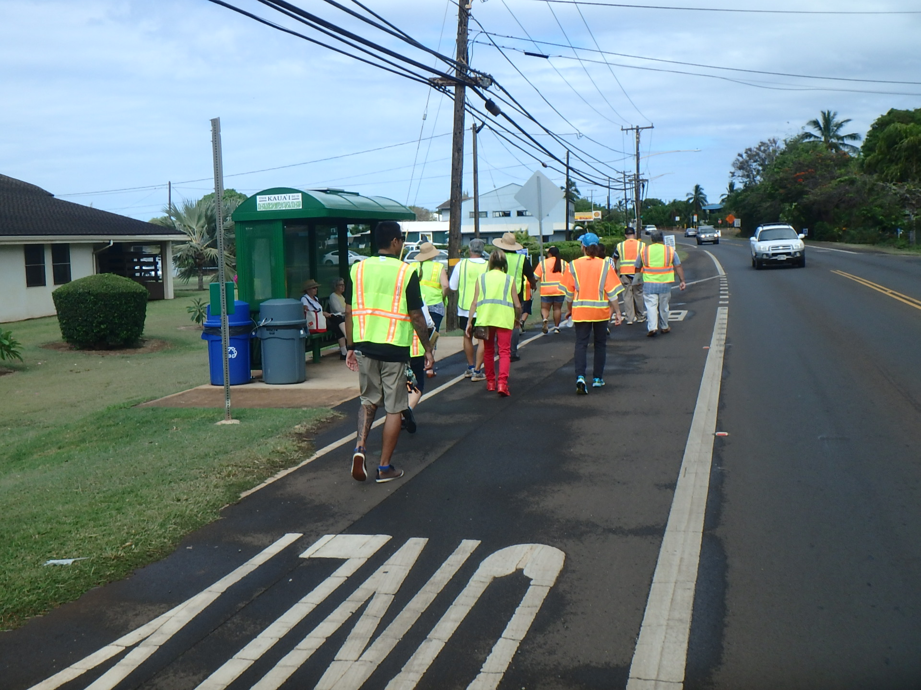
What does Transportation & Health collaboration look like?
Connecting with Public Health Stakeholders
Health professionals working on Safe Routes to School and increased physical activity
Metropolitan Planning Organizations integrating health impacts into their plans and project selection criteria
Applying tools like the FHWA Health in Corridor Planning Framework to inform decisions
Public Health initiatives for car seat checks and helmet fittings
Formal cooperation between Departments of Public Works, Planning, Health, and Safety
Interdisciplinary walk audits
Sheriff's
Dept.
Health
Dept.
Notes:
[NOTE TO SPEAKER – if you would like to highlight a specific type of agency example, there are ample options in the Guide. This slide is a compilation of many examples from the Guide. For additional example slides, please refer to the longer overview PPT doc on the NCHRP Guide page, available for download - http://bit.ly/TransportationHealthCommunicationsGuidebook ]
The Guide provides detailed real world examples of what Transportation and Health collaboration look like on the ground.
Here are several tangible actions and partnership to illustrate what it looks like when transportation and health work together.

Slide 7
For More Information
TRB Committee on Transportation and Public Health AME70
www.trbhealth.org
http://bit.ly/TransportationHealthCommunicationsGuidebook
Notes:
The Task 105 project resulted in several work products that are available for use along with the Guidebook. These include a quick reference file for those independent resources mentioned on the previous slide. A printable gives a quick overview of what the guidebook has to offer. A recorded overview presentation is available online with a little more detail than today’s presentation. A summary report gives a brief overview of all the work done for the project.

